Slide 1
Using Mantid with muon experiments and data
James Lord

Slide 2
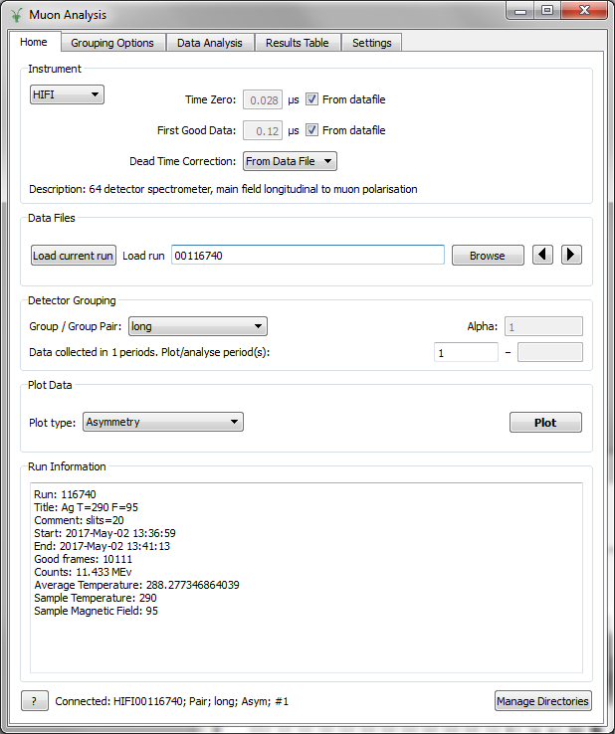
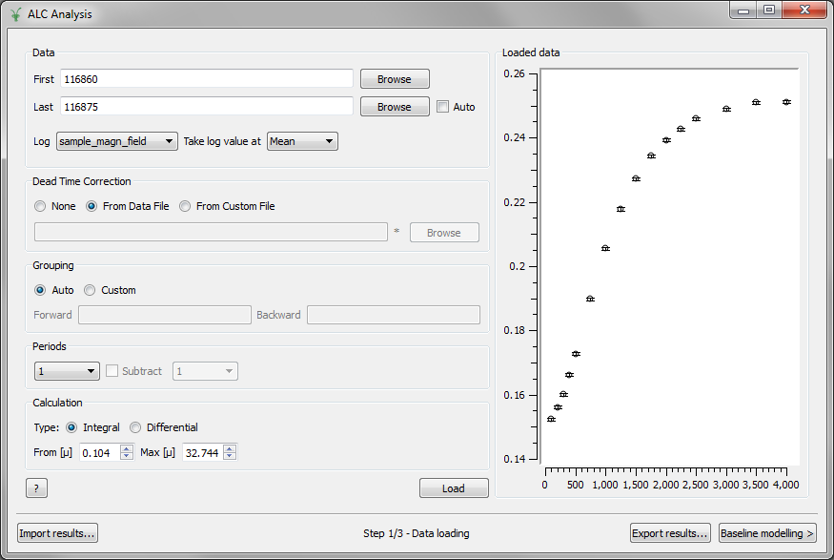
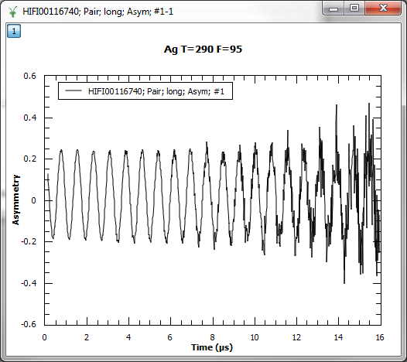
Muon interfaces

Slide 3
Simulations
QUANTUM program to model the interaction of muon spins with a sample
Solves Schrödinger’s equation using the density matrix method
Include dipole interaction, hyperfine coupling, quadrupole splitting, applied static or RF fields
Can be computationally intensive for large numbers of spins, high spin I, or dynamics
Generates P(t) as a series of oscillating terms
Evaluate into time bins, or integrate analytically to get integral asymmetry
Additional code for powder averaging, field scans, etc

Slide 4
Simulations
QUANTUM was originally a stand alone FORTRAN program using library routines from NAG or IMSL
Dialog boxes for input, became limitation
Rewritten in Python with NumPy library routines
Mantid algorithm
Input table to define model (flexible)
Useful to edit these tables interactively
Output to Workspaces

Slide 5
Simulation and Fitting
QUANTUM simulation also available as a fit function
Use within Muon Analysis, Muon ALC or a script
Vary model parameters to optimise fit
Simultaneous model/fit at several magnetic fields or temperatures

Slide 6
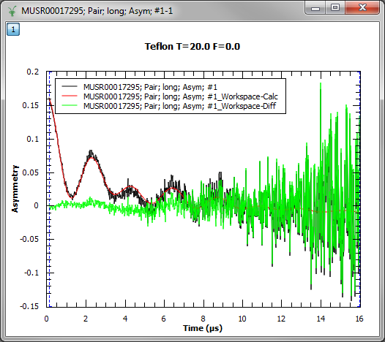
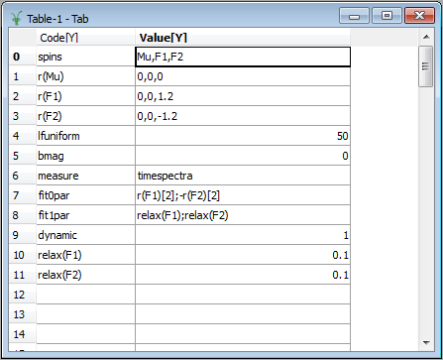
QUANTUM example
Data and fit
Model definition table

Slide 7
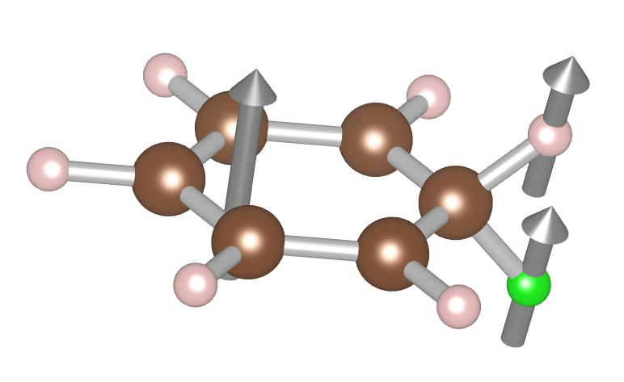
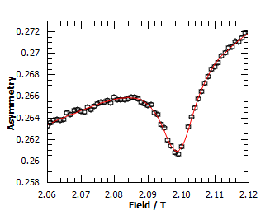
Example - ALC
A_{H}
Muon addition to benzene, forming radical
Level crossing when hyperfine coupling matches Zeeman splitting
Dip in asymmetry
Characteristic oscillations observed
H
e
µ
A_{µ}

Slide 8
Modelling
QUANTUM model with hyperfine couplings as parameters
Magnetic field set from run logs (NMR probe)
Additional parameters
Formation fraction
Formation delay
Spin relaxation
Background varying smoothly with field
Simultaneous fit of several runs across resonance

Slide 9
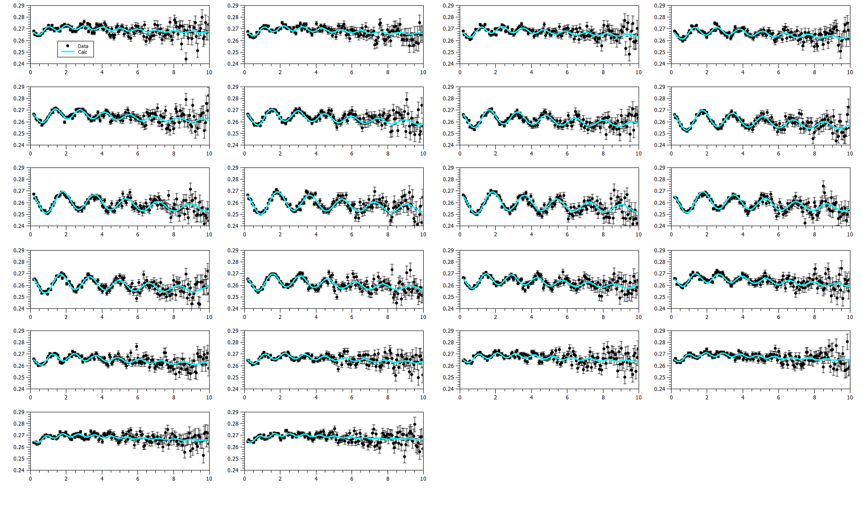
Fits
10mM Benzene in hexane
335K, 10G field steps
352 total parameters
110 fixed, 227 tied, 15 free

Slide 10
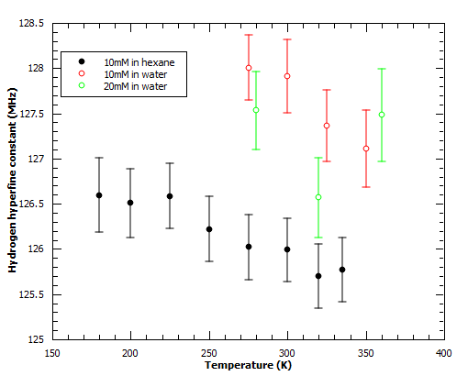
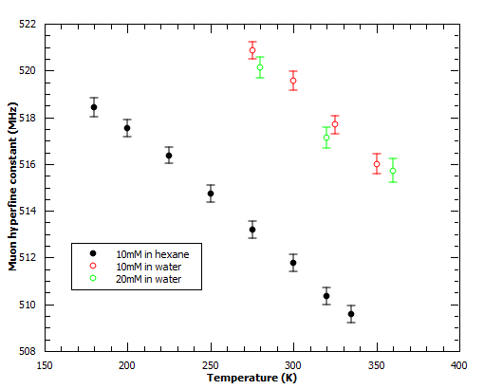
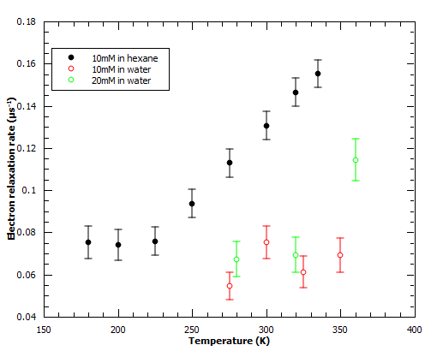
Results
Temperature and solvent varied

Slide 11
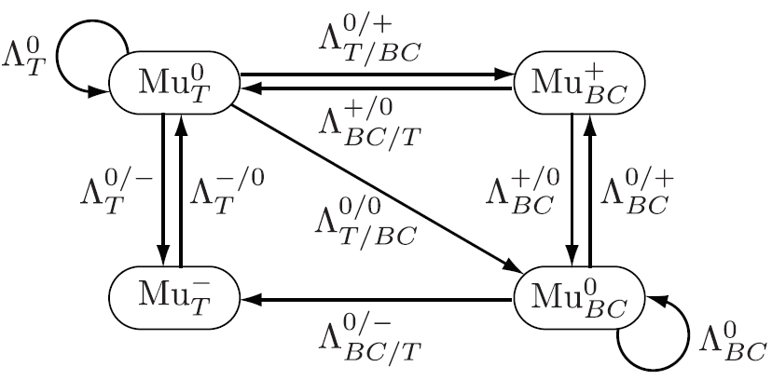
Example – site changes
Muons model hydrogen in silicon
Four combinations of site and charge
Two have unpaired electron
Transition and relaxation rates depend on e- or h+ concentration, and/or temperature
Illuminate sample, creates excess carriers
Several runs at different light intensity

Slide 12
Method
Calculate all transition rates from carrier concentrations (known per run) and cross sections (variable, global)
Set up QUANTUM model to simulate time dependence of asymmetry
Initial site populations also variable
Wrap in a Python fit function
Do simultaneous fit across many runs (different carrier injection levels)

Slide 13
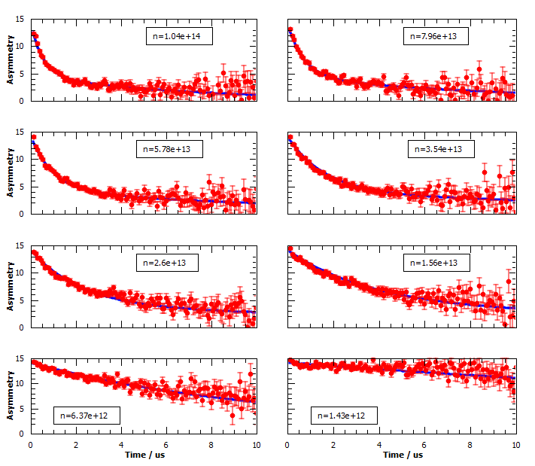
Fits
Intrinsic Si
B=100G (LF)
T=291K
Identify dominant relaxation pathways

Slide 14
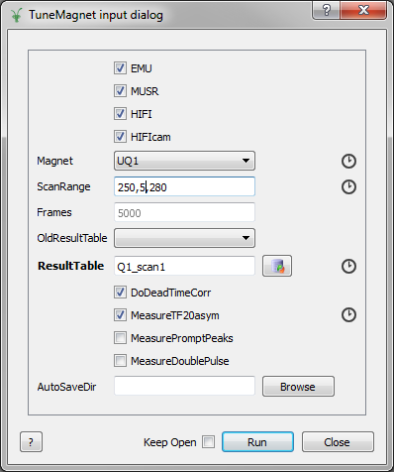
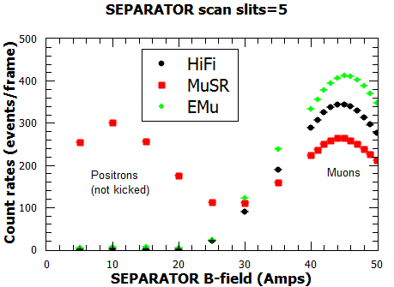
Instrument control
Used for beam tuning
Mantid algorithm:
Scan beam parameter (magnet or slits)
Coordinate data taking on three instruments
Analyse the results
Generate a summary table and plot
Find the optimum setting!

